Slide 1





ENGLISH LANGUAGE & LITERATURE
COMPARATIVE
essay structure
MYP 5 (TERM 2)

Slide 2

By the end of this presentation, students will be able to:
learning
OBJECTIVES
Identify the key features and purpose of a comparative essay.
Differentiate between integrated and block structures, explaining their strengths and limitations.
Organise ideas and evidence from two texts logically and cohesively into paragraphs.
Use comparative connectives and evaluative language to link similarities, differences, and nuanced perspectives.

Slide 3


what is comparative
ESSAY?
The key to a strong comparative essay is synthesis — weaving both texts into the same conversation.
You’ll often be looking at the same concept through two different lenses.
A comparative essay...
Examines two texts to reveal connections and contrasts
Considers key concepts such as themes, context, style or values
Goes beyond ‘Text A vs Text B’ to discuss the relationship/s between texts

Slide 4

choosing points of
Sometimes the essay question will determine the points of comparison for you to focus on. Sometimes you must determine them yourself.
Try not to compare everything. Choose focused ideas that best answer the question and that allow you to show meaningful analysis — not just superficial differences.
The following slides will outline some of the things you might be asked or required to compare...
COMPARISON

Slide 5

you might be asked to compare...
Themes & Ideas
Context
Characterisation
Purpose & Message
Similarities or differences in core themes (e.g., identity, power, justice, freedom)
Treatment of moral, ethical or philosophical questions about human experience
Historical, cultural, or social context influencing texts
How context shapes themes or characters etc.
How meaning can change over time based on context
Protagonists and antagonists: motivations, development and relationships
Representation of gender, race, class, or other identities through character
Author’s intended message or social critique
Whether the texts have similar or contrasting purposes

Slide 6
you might be asked to compare...
Perspective & Voice
Form & Genre
Style & Techniques
Text Structure
First-person vs third-person narration
How P.O.V, perspective and voice influence audience response
Reliability of narrator or point of view shifts
Novel vs film, poem vs play, etc.
How form affects meaning and audience engagement
Subversion of generic conventions for particular purposes
Use of imagery, symbolism, metaphor, irony to affect an audience
Language style: formal vs colloquial, poetic devices, diction
How these help to convey themes or ideas
Chronological vs non-linear narrative structure
Use of flashbacks, framing devices, or parallel plots
How structural features affect audience response

Slide 7
you might be asked to compare...
Tone & Mood
Setting & Atmosphere
Audience Response
Values & Attitudes
The physical location, time period and atmosphere conveyed in each text
How setting shapes the narrative and contributes to themes
Who the texts were written for and how they are received differently
How audience expectations shape the text’s style and content
Explicit or implicit attitudes or values conveyed through characters or plot
How these reflect or challenge societal norms
reflection of wider societal or cultural values or beliefs
The emotional atmosphere created by the text
How the author or narrator’s tone influences audience reaction

Slide 8


comparative essay
Introduction
Introduce both texts, authors, and context
Present a thesis outlining similarities and differences
Body Paragraphs
State main idea/s
Compare and contrast between two texts
Give supporting evidence
Conclusion
Summarise main comparisons
Reinforce your argument’s significance
STRUCTURE
A basic comparative essay will follow
this structure...
There are two approaches to body paragraphs - integrated and block.
We’ll outline some of the key differences on the next slide.

Slide 9
BLOCK
An example structure for three body paragraphs:
approach
Paragraph 1
Both ‘The Last Harvest’ and ‘Seeds of Tomorrow’ explore the destructive potential of human greed, but while the short story uses a cautionary narrative, the poem evokes a sense of loss through natural imagery.
Paragraph 2
In portraying the relationship between humans and the environment, ‘The Last Harvest’ highlights technological dominance, whereas ‘Seeds of Tomorrow’ focuses on the resilience of nature despite exploitation.
Paragraph 3
Although each text ends with a warning, ‘The Last Harvest’ offers a bleak, irreversible conclusion, while ‘Seeds of Tomorrow’ suggests the possibility of renewal through collective action.
The block approach discusses all ideas for one text first then moves on to the second text.
This can be an easier choice if you’re just getting started with comparative essay as it is clearer to organise, however, it risks being too separate and less comparative.

Slide 10
INTEGRATED
An example structure for four body paragraphs:
approach
Text A: ‘The Last Harvest’ (Short Story)
Paragraph 1 - Through a cautionary narrative voice, The Last Harvest critiques the relentless pursuit of profit, showing how greed accelerates environmental collapse.
Paragraph 2 - The story uses stark technological imagery to symbolise humanity’s control over nature, ultimately revealing its destructive consequences.
Text B: ‘Seeds of Tomorrow’ (Poem)
Paragraph 3 - In contrast, Seeds of Tomorrow employs rich natural imagery and metaphor to highlight the resilience of the environment despite human exploitation.
Paragraph 4 - Concluding with an optimistic call to action, the poem positions the reader as an agent of change, offering hope for renewal.
The integrated approach compares ideas and techniques from both texts in every paragraph, creating an ongoing dialogue.
While it’s a little bit more challenging than the block approach, it can come across as more eloquent, sophisticated and effective if done well.

Slide 11


comparative
CONNECTIVES
Similarities
Differences
Regardless of the approach you choose, it’s extremely important to use comparative phrases.
These are your signposts. They make it obvious to the marker that you are actively comparing and analysing the relationship between the two texts, not just describing or discussing each text separately.
similarly
likewise
in the same way
both texts
just as
equally
correspondingly
alike
however
in contrast
unlike
whereas
on the other hand
although
yet
conversely

Slide 12


evaluative
Examples:
Positive: “The sharp wit of the narrator enhances the satire.”
Negative: “The inconsistent pacing weakens the story’s momentum.”
Balanced: “While the protagonist’s vulnerability adds depth, the predictable ending reduces its emotional impact.“
LANGUAGE
Evaluative language is when you express a judgement about a text, idea, or element — not just describing it, but assessing its effectiveness or impact.
It can be positive, negative, or balanced, and is used in comparative essays to show critical thinking.
Tips for Using Evaluative Language:
Go beyond “good” or “bad”
— be specific about why.
Link to evidence from the text.
Maintain an academic tone.

Slide 13

paragraph
STRUCTURE
Let’s look at a guide on how to structure the paragraphs of a comparative essay a little more closely. Keep in mind that this is just a guide and you may make adjustments depending on the essay question, word count and focus.

Slide 14


INTRODUCTION
Your thesis statement and essay focus will determine what kind of hook you need.
Hook
Grab attention with a striking observation, question, or brief reference to a shared theme.
List the title, author or director and year of publication (if relevant).
Introduce Text/s
Use key words from the essay question.
Shared Connection
Briefly explain what links the texts (e.g., theme, context, issue, perspective).
Thesis Statement
Your overall argument about what comparing these texts reveals (linked to the essay question)
This is optional. Some essays choose not to include a menu.
Menu
Briefly outline the key points or paragraph topics.

Slide 15
INTRODUCTION SAMPLE
Hook
The relationship between people and the land is often shaped by memory, necessity, and hope for the future. In the short story, ‘The Last Harvest’ (2012) by Marjorie Lane, the final gathering of crops in a drought-stricken valley is infused with nostalgia and sorrow, as the community reflects on generations of agricultural tradition. By contrast, the poem ‘Seeds of Tomorrow’ (2018) by Callum Reeve depicts an agricultural scientist developing drought-resistant plants in a futuristic research facility, framing the land as a site for renewal rather than loss. While both texts acknowledge the fragility of the natural world, ‘The Last Harvest’ mourns what is being lost, whereas ‘Seeds of Tomorrow’ imagines what could still be saved. Through the use of symbolism, tone, and character perspective, each text offers a distinct but interconnected vision of humanity’s bond with the earth.
Introduce
Text/s
Thesis Statement
Menu

Slide 16

BODY PARAGRAPHS
This structure is for an integrated response.
For a block response, focus on one text per paragraph but still use comparative connectives regularly when you discuss the second text.
Topic Sentence
States the main idea of the paragraph. This is usually a pub-point derived from your thesis.
Discuss Text 1: Key scene/quotation + technique + effect.
Link to Text 2: Similarity/difference in idea or technique.
Use comparative connectors e.g. “Similarly,” “In contrast,” “Unlike,” “Both texts,” “While Text 1…, Text 2…”
Comparison
of Texts
Give quote/s or specific details from each text. Identify the technique (e.g., metaphor, camera angle, symbolism) then explain the effect and how it shapes meaning.
Evidence & Analysis
Contextual Insight
Link to social/historical/cultural context if relevant.
Link Back
Reinforce how this comparison supports your thesis.

Slide 17
BODY PARAGRAPH SAMPLE
Topic Sentence
Both ‘The Last Harvest’ and ‘Seeds of Tomorrow’ use symbolism to convey their contrasting views on humanity’s relationship with the land. In ‘The Last Harvest’, the image of “withered corn stalks bowing under the weight of dust” symbolises not only the physical toll of the drought but also the decline of generational farming traditions. The bowed stalks mirror the weary bodies of the farmers themselves, suggesting surrender in the face of environmental and economic pressures. In contrast, ‘Seeds of Tomorrow’ employs the recurring symbol of “glass pods of sleeping seeds” to represent untapped potential and the possibility of renewal. Unlike the decaying crops in Lane’s story, Reeve’s seeds are dormant, not dead, positioning the future as something that can still be nurtured if action is taken. Together, these symbols frame the land as both a record of the past and a blueprint for the future, prompting readers to consider whether decline is inevitable or preventable.
Comparison of Text 1 -
Evidence & Analysis
Comparison of Text 2 - Evidence & Analysis
Link Back

Slide 18

CONCLUSION
Your thesis statement and essay focus will determine what kind of hook you need.
Restate your thesis in a fresh way — remind the reader of your main insight about the two texts.
Avoid simply repeating your introduction; focus on the “big picture” significance.
Topic Sentence
Synthesise key comparative insights outlined in your body paragraphs. Show how your points link together by making connections between the two texts rather than listing them.
Use key words from the essay question.
Summary
This is optional. Some essays choose not to include a menu.
End with a final insight or broader implication. Suggest why your comparison matters — relate it to a universal theme, a contemporary relevance, or a lasting impact of the texts.
Final Statement

Slide 19
CONCLUSION SAMPLE
Topic
Sentence
By contrasting Lane’s bleak portrayal of agricultural decline in ‘The Last Harvest’ with Reeve’s hopeful vision in ‘Seeds of Tomorrow’, it becomes clear that both texts grapple with the fragile relationship between humanity and the environment, yet offer sharply different resolutions. Through their use of symbolism, tone, and imagery, Lane frames the land as a site of irreversible loss, while Reeve positions it as a source of potential renewal. Together, these works remind readers that the way we choose to represent the future—whether as decay or growth—shapes how we respond to the challenges of our time. Ultimately, the comparative study of these texts reveals that the conversation between pessimism and hope is as vital to literature as it is to the decisions we make about the world we inhabit.
Summary
Final
Statement

Slide 20

Always link comparisons and analysis back to the essay question
final
Keep both texts in focus and provide a balanced discussion of each
TIPS
Analyse techniques, language features and literary devices not just plot
Use integrated direct evidence from both texts where possible
Write with clarity and precision and avoid unnecessary waffling

Slide 21

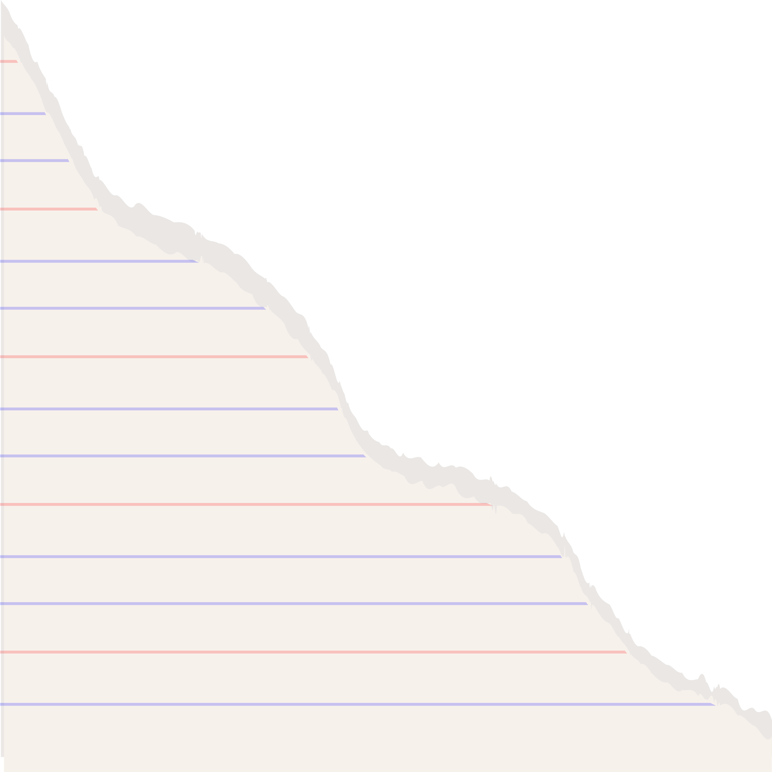

thanks for
LISTENING
& good luck!

Slide 22

Press these keys while on
PRESENT MODE
B for
blur
D for a drumroll
O for
bubbles
U for
unveil
C for
confetti
M for micdrop
Q for
quiet
Any number from 0-9 for a timer

Slide 23










RESOURCES
Use this element set in your Canva Presentation. Don't forget to delete this page before presenting.
set:nAE-3XXmQts

